Slide 1
RESOLUTION
THE MTA RESOURCES ON THE ISRAEL/GAZA CONFLICT
Dr. Jesse Hefter
Brookline School Committee
jesse_hefter@psbma.org
May 1, 2025

Slide 2
WHY A RESOLUTION?
Support our teachers, our curriculum coordinators, and our district family (parents and students)
Express our concern as School Districts to the MTA
J. Hefter, Brookline School Committee, May 1, 2025

Slide 3
SET THE STAGE…
After the Hamas attack on Israel of October 7, 2023, the MTA assembled a set of resources for its member teachers ”to help educators engage with their students on this crucial and difficult topic”
“The list is dominated by Palestinian and anti-Zionist voices, while voices humanizing Israeli experiences or representing a Zionist narrative are minimal” (Shira Schoenberg – Boston Globe Opinion, January 2025)
J. Hefter, Brookline School Committee, May 1, 2025

Slide 4
FOR EXAMPLE…
The MTA introduced a dramatically one-sided set of “curriculum resources” to its members concerning “the history of Israel and occupied Palestine,” that demonizes the only Jewish State and threatens to politicize classrooms, American Jewish Committee (AJC) New England
Of the 89 resources listed by the MTA, 67 characterize Israel as an illegitimate state and/or reduce a complex conflict to allegations of wrongful occupation (others discussed antisemitism, Islamophobia, teaching difficult issues, and modeling balanced presentations of the Israeli-Palestinian conflict).
https://www.ajc.org/news/ajc-new-england-exposes-mtas-anti-israel-propaganda-a-threat-to-k-12-education
J. Hefter, Brookline School Committee, May 1, 2025

Slide 5
FOR EXAMPLE…
During a legislative hearing (February 10, 2025), the House Chair of the Special Commission on Combating Antisemitism, Rep. Simon Cataldo, called an MTA resource page on the Israel-Hamas war "virulently antisemitic." Co-Chair Sen. John Velis said the materials were "incredibly one-sided.”
https://www.wbur.org/news/2025/02/20/mta-materials-israel-hamas-war-antisemitic
J. Hefter, Brookline School Committee, May 1, 2025

Slide 6
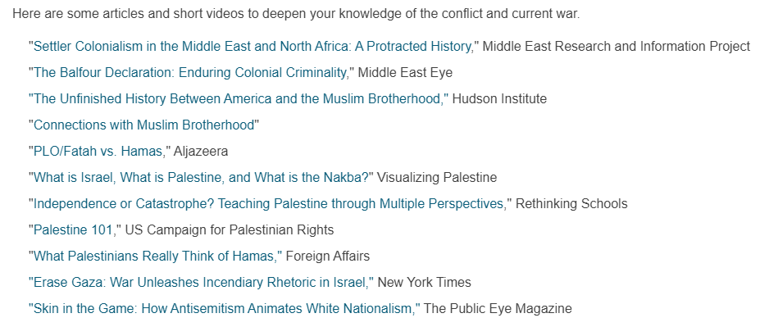

FROM THE MTA RESOURCES
J. Hefter, Brookline School Committee, May 1, 2025

Slide 7
FROM THE MTA RESOURCES
Zinn Education Project
This organization was co-founded by Rethinking Schools and Teaching for Change and inspired by the work of Howard Zinn, whose work, "A People’s History of the United States," challenged dominant narratives in American history. The project offers free resources to help educators teach lessons that are “engaging, accurate, and complex.” This resource includes lessons and suggestions for teaching in the K-12 setting. The following articles may be of particular interest.
  "Teaching About Palestine-Israel and the Unfolding Genocide in Gaza"
  "Teaching the Seeds of Violence in Palestine-Israel"
  "Teaching Media Literacy on Palestine and Israel"
  "Independence or Catastrophe? Teaching Palestine Through Multiple Perspectives"
J. Hefter, Brookline School Committee, May 1, 2025

Slide 8
FROM THE MTA RESOURCES
VISUALS & ART
Museum of the Palestinian People Virtual Tour
The Museum of the Palestinian People, based in Washington D.C., is devoted to preserving and celebrating Palestinian history, arts and culture.
NEA'S EFFORT TO COLLECT HUMANITARIAN AID FOR EDUCATORS AND STUDENTS IN GAZA
NOTE: These are the ONLY resources listed under these headings (NOTHING ABOUT ISRAEL)
J. Hefter, Brookline School Committee, May 1, 2025

Slide 9
FROM THE MTA RESOURCES
Documentaries and Films (17 listed as of 3/20/2025)
  Israel
    One documentary about the October 7, 2023, massacre at the Nova Dance Festival
  Palestine
    At least 13 of the other 16 express a pro-Palestinian narrative
J. Hefter, Brookline School Committee, May 1, 2025

Slide 10
FROM THE MTA RESOURCES
Eleven (11) books, 7 are problematic
  Adwan, et. Al – Side by Side: Parallel Histories of Israel-Palestine
  Aslan – a kids book about Israel & Palestine
  Finkelstein – Gaza: An Inquest into its Martyrdom
  Kalidi – The Hundred Year’s War on Palestine
  Pappe – TEN MYTHS ABOUT ISRAEL
  Said – The Question of Palestine
  Shavit – My Promised Land
J. Hefter, Brookline School Committee, May 1, 2025

Slide 11
BROOKLINE SCHOOL COMMITTEE RESOLUTION REGARDING THE MASSACHUSETTS TEACHERS ASSOCIATION’S CURRICULAR MATERIALS ON THE ISRAEL-GAZA CONFLICT
WHEREAS, the Massachusetts Teachers Association (MTA) disseminated resources related to the Israel-Gaza conflict and its history, that contain unambiguous antisemitic elements; and
WHEREAS, these particular materials impact the Jewish community and are offensive, and undermine a balanced and fair presentation of this international issue; and
WHEREAS, the MTA's materials have been critically and publicly exposed by the Massachusetts Special Commission on Combating Antisemitism; and
WHEREAS, the use of these materials in any school district could create an environment that undermines the values of impartial education and mutual respect among students and staff of diverse backgrounds;
THEREFORE, BE IT RESOLVED that the Public Schools of Brookline strives to foster an educational setting that is respectful, historically accurate, and free from discrimination; and
BE IT FURTHER RESOLVED that the Brookline School Committee strongly cautions our District staff about utilizing the MTA's materials related to the Israel-Gaza conflict; and
BE IT FURTHER RESOLVED that the Brookline School Committee intends to create an Instructional Materials policy that prevents the dissemination of antisemitic and other discriminatory content in our District; and
BE IT FURTHER RESOLVED that the Brookline School Committee calls upon our District to follow the guidelines reiterated by the United States Department of Education Office of Civil Rights in a letter dated May 25, 2023 of “schools’ legal obligation under Title VI of the Civil Rights Act of 1964 (Title VI) to provide all students, including Jewish students, a school environment free from discrimination based on race, color, or national origin, including shared ancestry or ethnic characteristics”.
J. Hefter, Brookline School Committee, May 1, 2025
Adopted May 1, 2025

Slide 12
BROOKLINE SCHOOL COMMITTEE RESOLUTION REGARDING THE MASSACHUSETTS TEACHERS ASSOCIATION’S CURRICULAR MATERIALS ON THE ISRAEL-GAZA CONFLICT
Resources:
U.S. Department of Education Office for Civil Rights, Letter of May 25, 2023 (https://www.ed.gov/sites/ed/files/about/offices/list/ocr/docs/antisemitism-dcl.pdf)
U.S. Department of Education Office for Civil Rights, Fact Sheet: https://www.ed.gov/sites/ed/files/about/offices/list/ocr/docs/ocr-factsheet-shared-ancestry-202301.pdf (January 2023).
Curriculum Guidelines (Policy Manual - File: IJ - Instructional Materials; MA School Districts including Arlington, Bedford, Framingham, Lexington, Lynn, Malden, Newton, Plymouth, Swampscott, Watertown, Westborough, Worcester)
Appendix of AJC Report of Politicization of K-12 Classrooms and the MTA Curricular Resources - https://url.us.m.mimecastprotect.com/s/xIDvCM851gcyABAVhwf5c89UNZ?domain=ajc.org
J. Hefter, Brookline School Committee, May 1, 2025

Slide 13
WHAT’S NEXT
SHARE RESOLUTION WITH…
School District Curriculum Staff
Massachusetts Association of School Committees
MA Special Commission on Combating Antisemitism
Department of Elementary and Secondary Education
State Attorney General Office of Civil Rights
J. Hefter, Brookline School Committee, May 1, 2025

